Slide 1
Data Preparation « Primary Education »
Project 3:
By: Anh Huynh

Slide 2
Contents
Import the data using Pandas.
Examine the data for the issues (missing data, wrong data….)
Produce a Python code and explain how to clean and transform data set.
Export clean version of data into CSV.
Export clean data into MySQL using Pandas.
Analyzing 3 tables of the dataset in MySQL.

Slide 3
Primary Education.xlsx
Import data:
import pandas as pd
import numpy as np
data=pd.read_excel(r'C:\Users\Documents\CODE DATA ANALYSIS\Module 1\Project 3\Primary Education.xlsx')

Slide 4
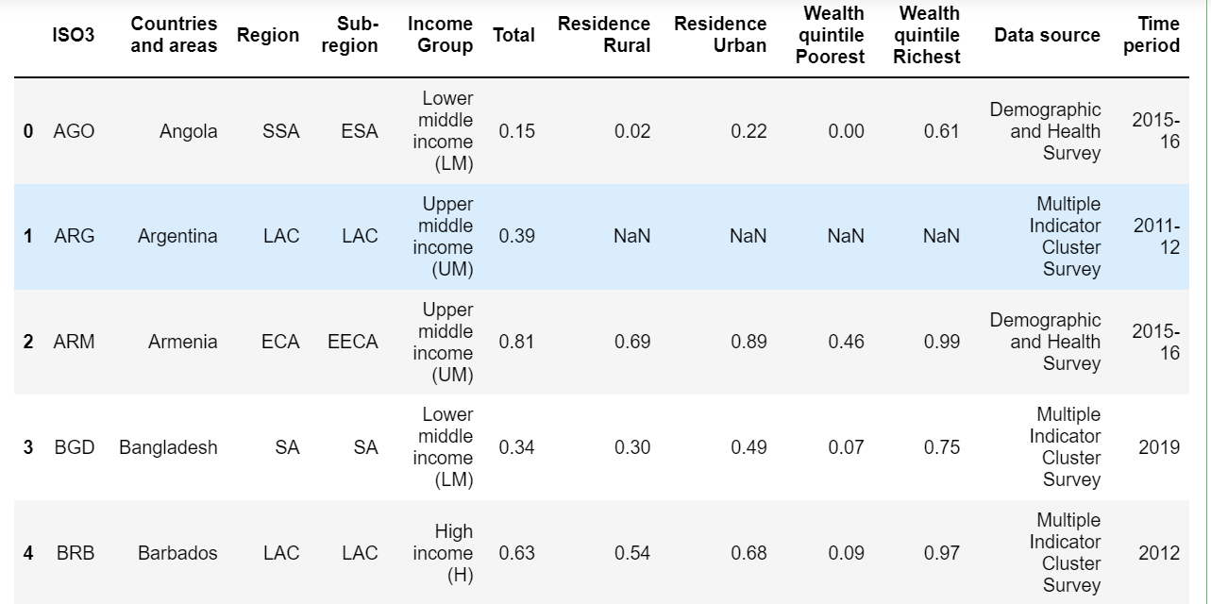
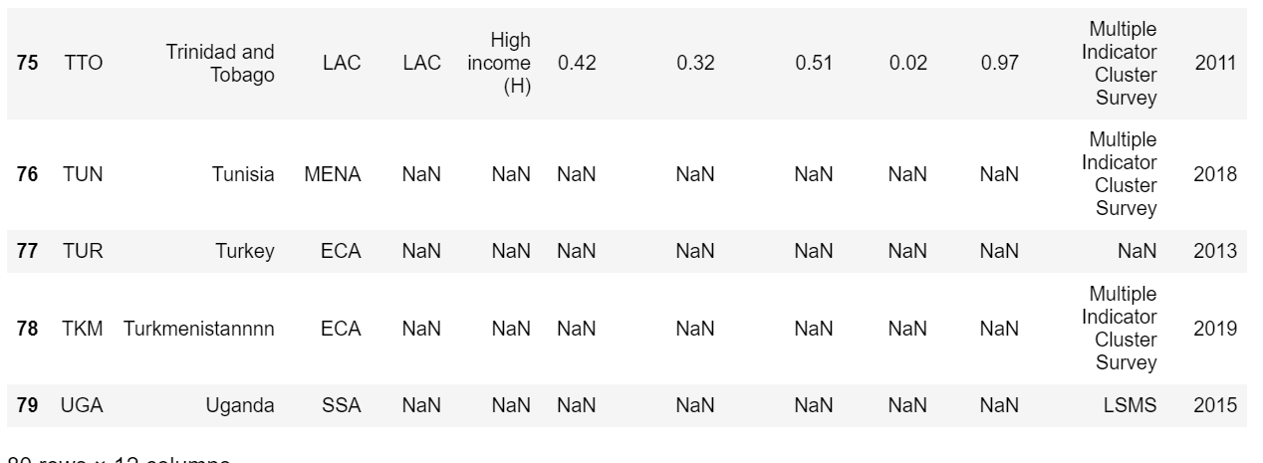
£

Slide 5
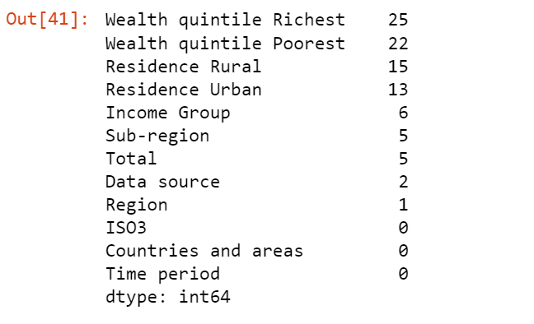
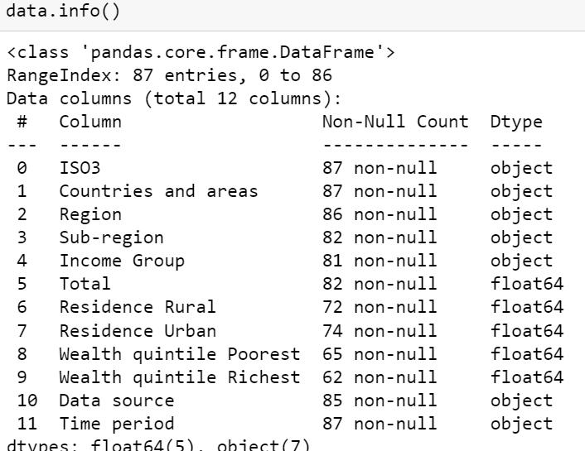
#Examine the data for the issues data.isna().sum().sort_values(ascending=False)

Slide 6
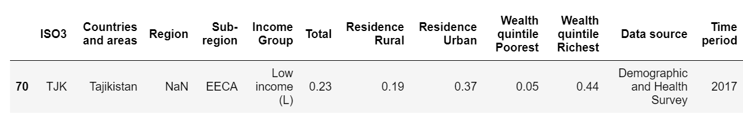
JME_Regional-Classifications.xlsx
data[data['Region'].isna()]
data['Region']=data['Region'].replace(np.nan,'ECA')

Slide 7
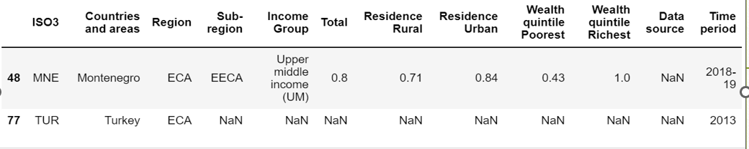
*Adding the frequently value
list(data['Data source'].mode())
data['Data source']=data['Data source'].replace(np.nan,'Multiple Indicator Cluster Survey')

Slide 8
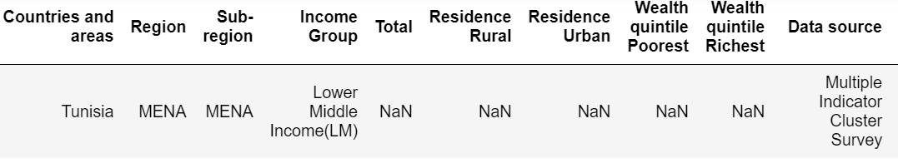
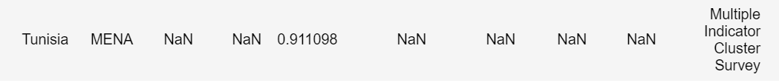
#Fill missing value with mean value
data['Total']=data['Total'].replace(np.nan,data['Total'].mean())

Slide 9
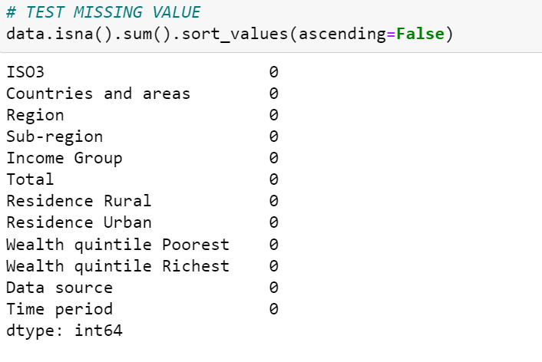

Slide 10
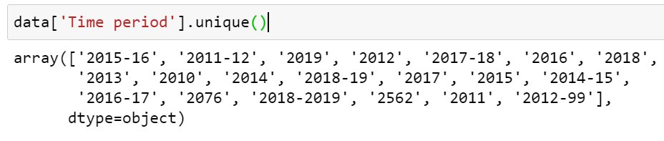
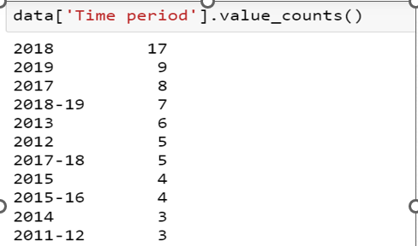
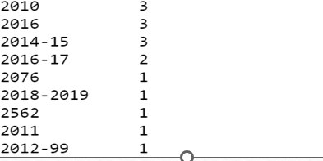
Wrong data- Time period

Slide 11
#Fixing wrong years: 2562, 2076 and 2012-99---row 71,51,82
data['Time period'] = data['Time period'].replace(['2562'], '2018')
data['Time period'] = data['Time period'].replace(['2076'], '2018’)
data.loc[82,'Time period'] = 2012

Slide 12
data.to_csv(r'Primary output.csv’)
import mysql.connector
mydb = mysql.connector.connect(
host= "",
user="",
password= ""
print(mydb)

Slide 13
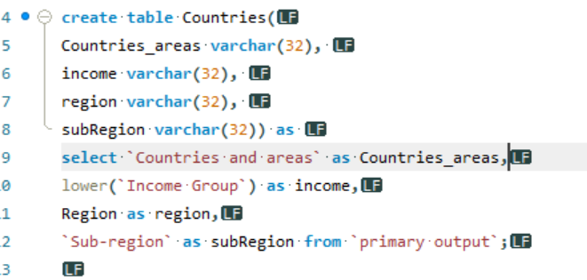
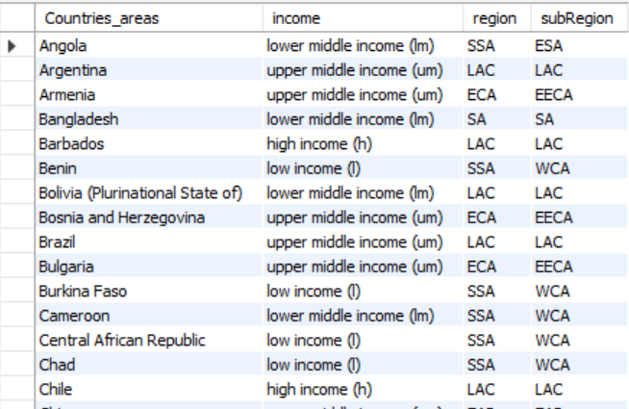
Create table by SQL

Slide 14
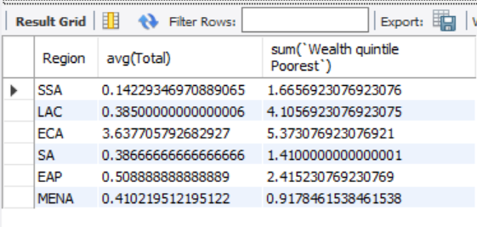
Using « group by »
select Region, avg(Total), sum(`Wealth quintile Poorest`) from `primary output` group by Region

Slide 15
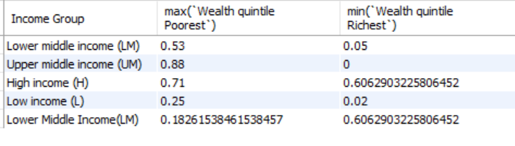
Example with max and min
Select `Income Group`, max(`Wealth quintile Poorest`), min(`Wealth quintile Richest`) from `primary output` group by `Income Group`;

